Slide 1
Project 1
Nicholas Vandra

Slide 2
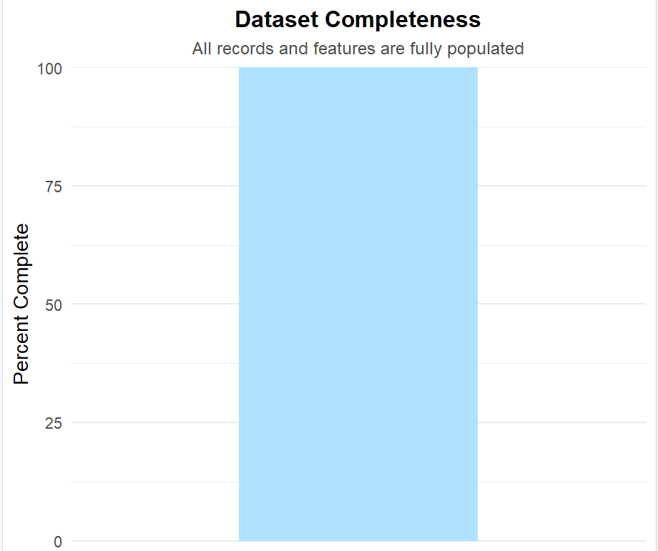
Missing Data
Every feature in the dataset has 100 % completeness, meaning no missing or null values.
This confirms that the dataset is clean and ready for analysis, reducing preprocessing complexity.
Completeness ensures that the model’s results are reliable and unbiased, since no information had to be imputed.

Slide 3
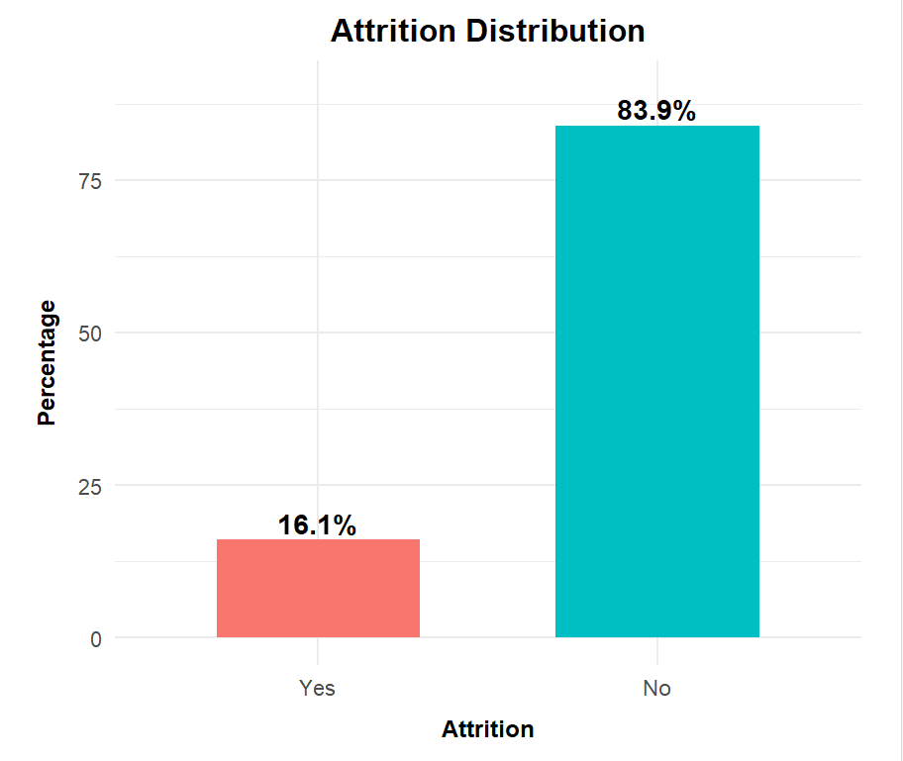
Attrition Class Distribution
About 16 % of employees left (Yes to attrition), while the majority stayed.
This creates a class imbalance, which can bias machine learning models toward predicting No.
Recognizing this early justifies using oversampling or balancing steps to avoid misleading accuracy.

Slide 4
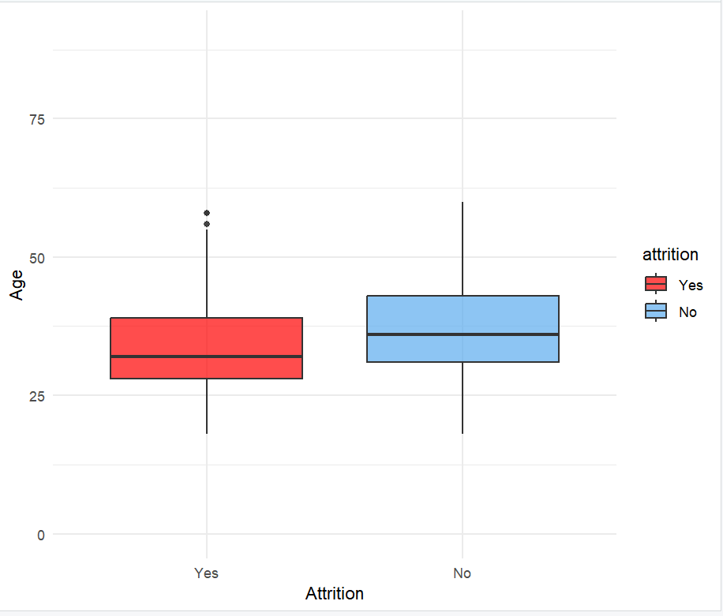
Age Distribution by Attrition
Employees who left are mostly in their 20s and early 30s, while older workers tend to stay.
Indicates that early-career employees may face unmet expectations or limited advancement.
Suggests the company should strengthen mentorship and career-path programs for younger staff.

Slide 5
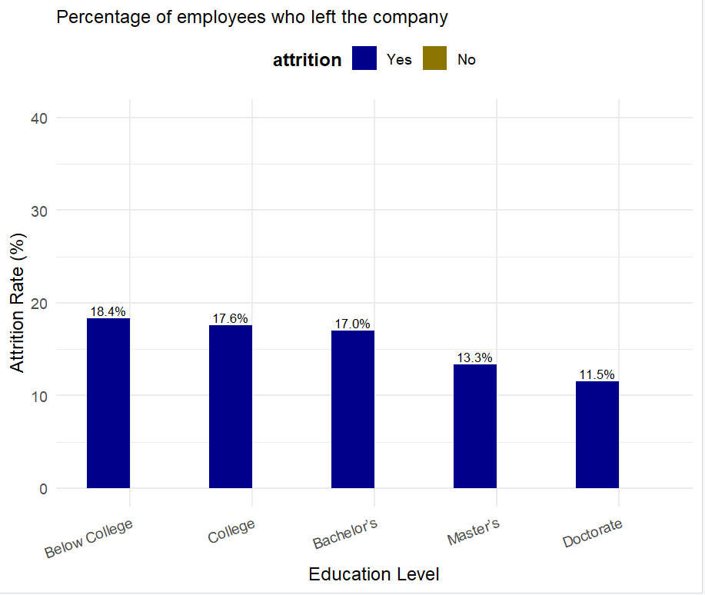
Attrition Rate by Education Level
Attrition declines as education level rises meaning workers with graduate degrees leave least often.
Higher education may correlate with job stability or career satisfaction.
Highlights potential value in education linked retention efforts such as training or tuition support.

Slide 6
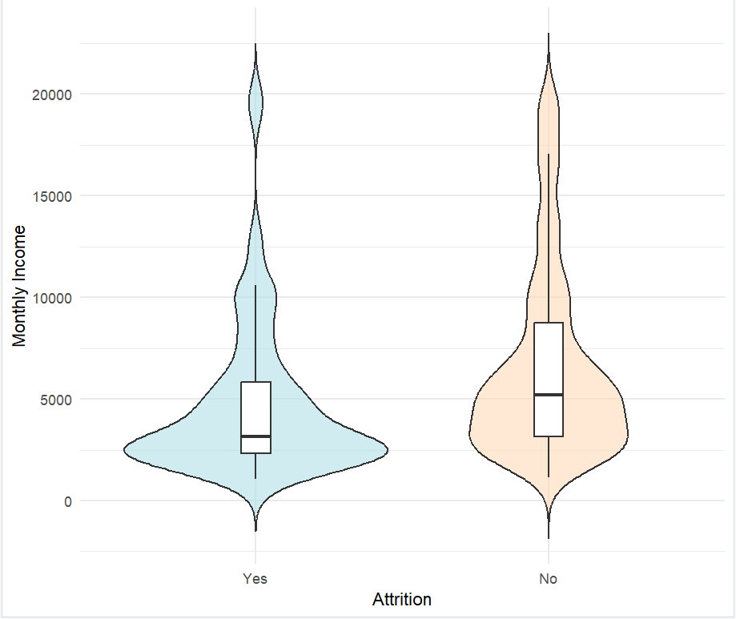
Distribution of Monthly Income by Attrition Status
Employees who left generally earned lower monthly income than those who stayed.
Reinforces that compensation is a major motivator behind attrition.
Suggests reviewing pay structures or implementing merit based incentives could improve retention.

Slide 7
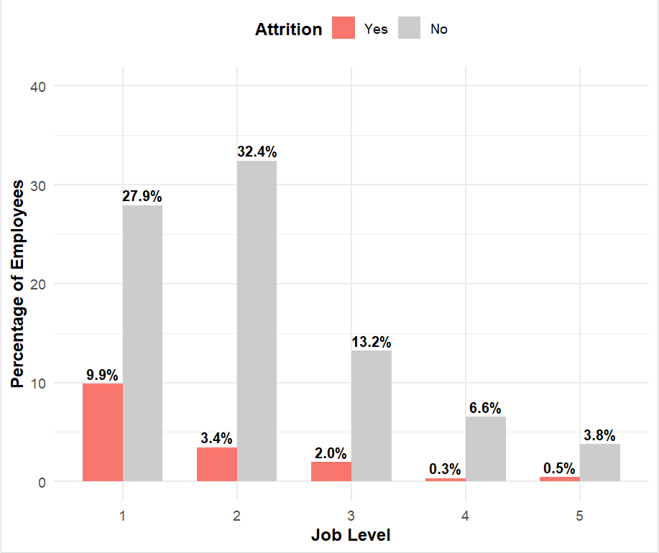
Attrition by Job Level
Attrition is heavily concentrated at Job Levels 1 and 2, the lowest tiers.
Senior level staff show far greater stability, likely due to higher pay and job satisfaction.
Indicates a need for career growth and support programs for lower level employees.

Slide 8
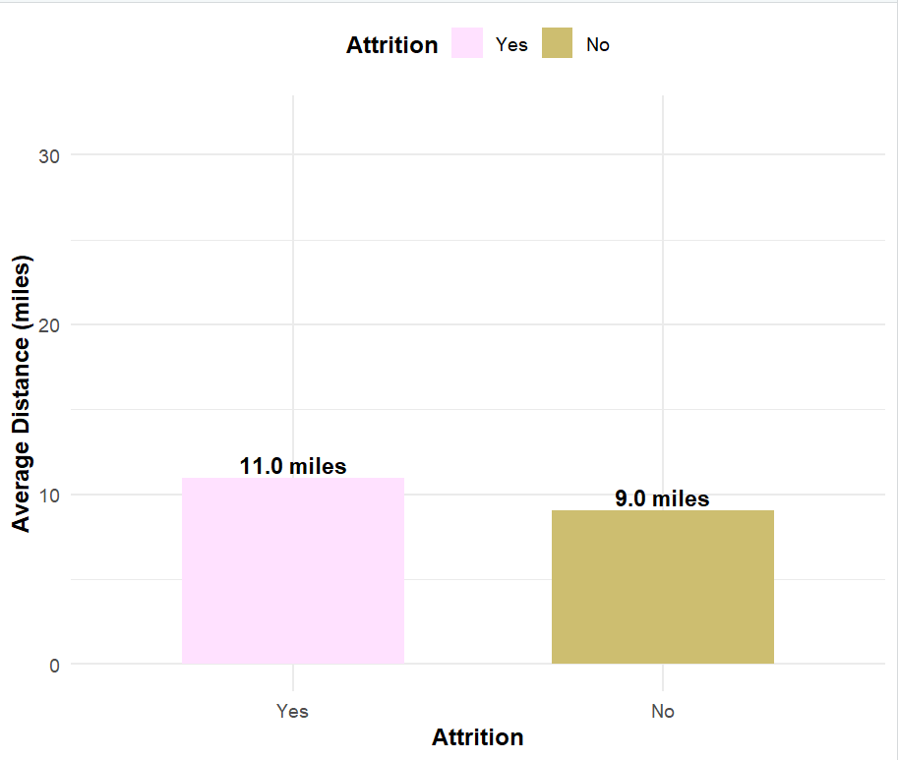
Average Distance from Home by Attrition Status
Workers who commute longer distances are more likely to leave the company.
Longer commutes can reduce work life balance and morale.
Suggests the benefit of remote work options or flexible scheduling to reduce turnover.

Slide 9
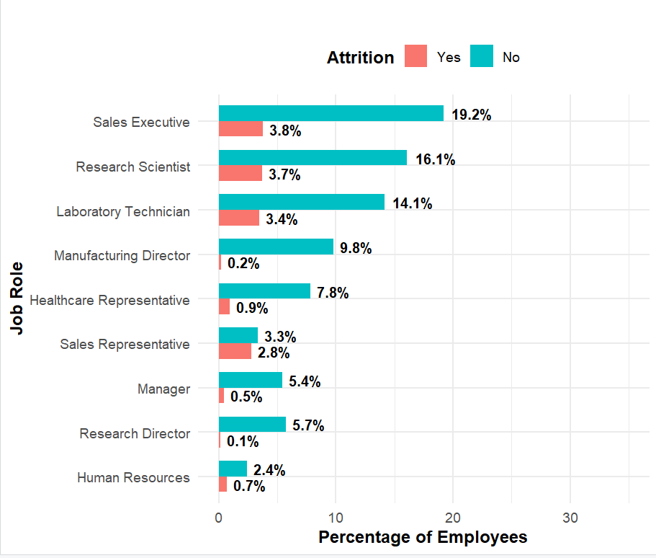
Attrition by Job Role
Sales and Laboratory Technicians have the highest turnover rates.
Roles with repetitive tasks or high pressure may contribute to dissatisfaction.
Points to the need for role specific interventions, such as improved support or training.

Slide 10
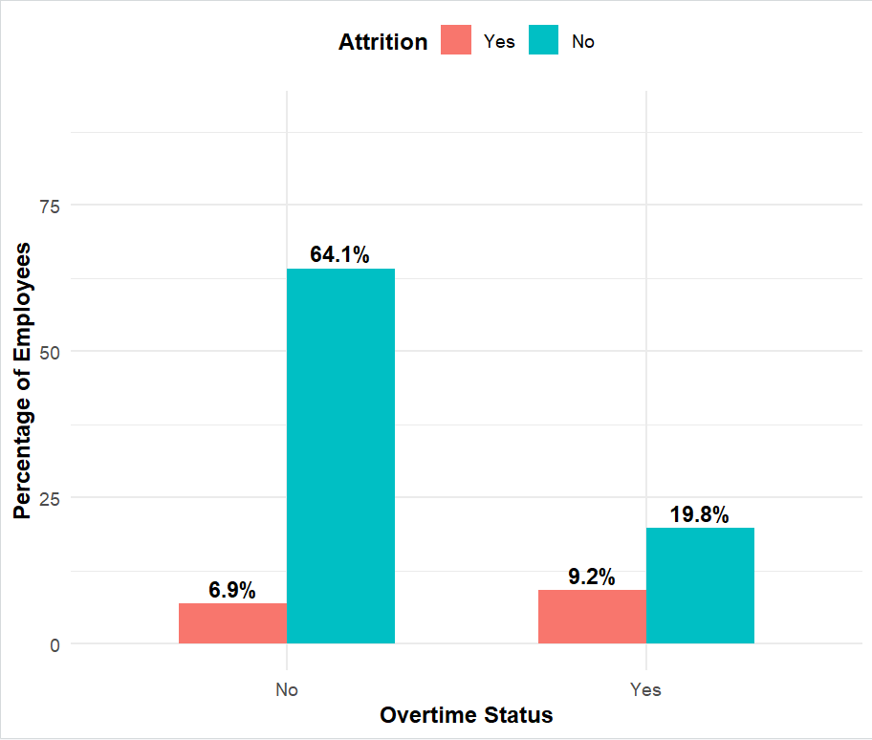
Attrition by Overtime
Employees working overtime have substantially higher attrition rates.
Indicates possible burnout and workload fatigue.
Highlights the importance of managing overtime hours and ensuring fair workload distribution.

Slide 11
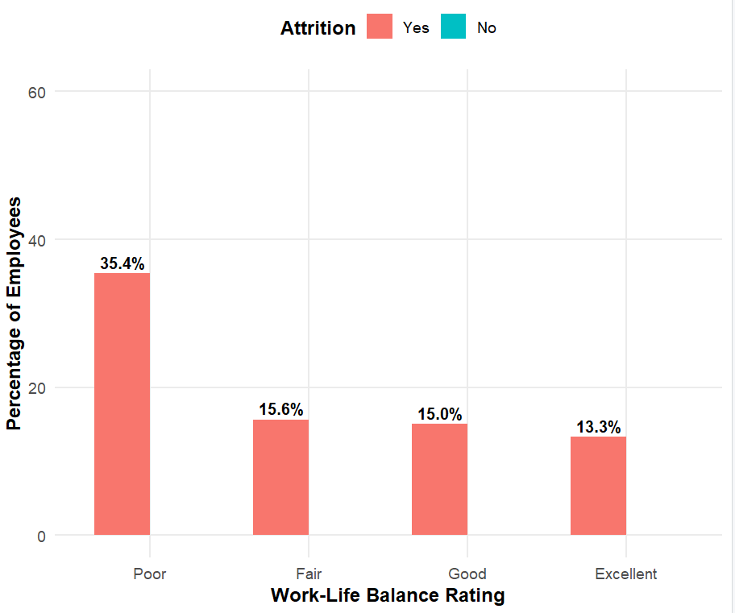
Attrition by Work Life Balance
Attrition rises sharply among those rating their work-life balance poorly.
Employees who feel supported and balanced tend to remain longer.
Suggests investing in wellness initiatives, flexible schedules, and time off programs.

Slide 12
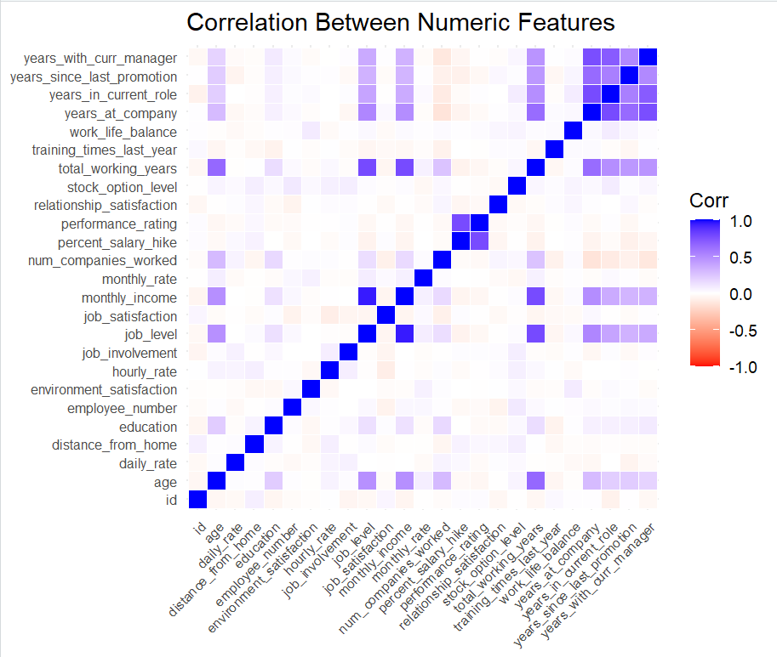
Numeric Correlation Heatmap
The plot highlights strong positive correlations among Age, Years at Company, and Monthly Income, meaning older employees tend to earn more and have longer tenure.
Distance from Home shows little to no correlation with other variables, suggesting it behaves independently of career related factors.
The overall pattern reflects real world workforce trends, where experience and pay typically rise together.
The color gradient clearly shows how closely each numeric variable moves with others, helping identify natural groupings in the data.

Slide 13
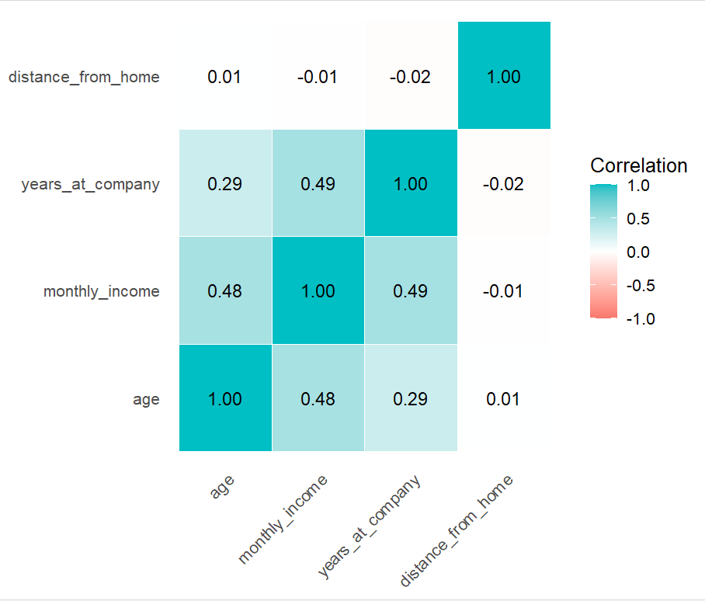
Correlation between Key Numeric Variables
The plot shows that employees with lower Monthly Income and shorter Years Company have the highest attrition rates.
Age follows a similar pattern in that younger employees are more likely to leave, while older workers stay longer.
Distance from Home stands out. Employees living farther away tend to leave more often, highlighting a lifestyle factor.
Overall, the chart illustrates how income, tenure, and commute distance shape who stays and who leaves.

Slide 14
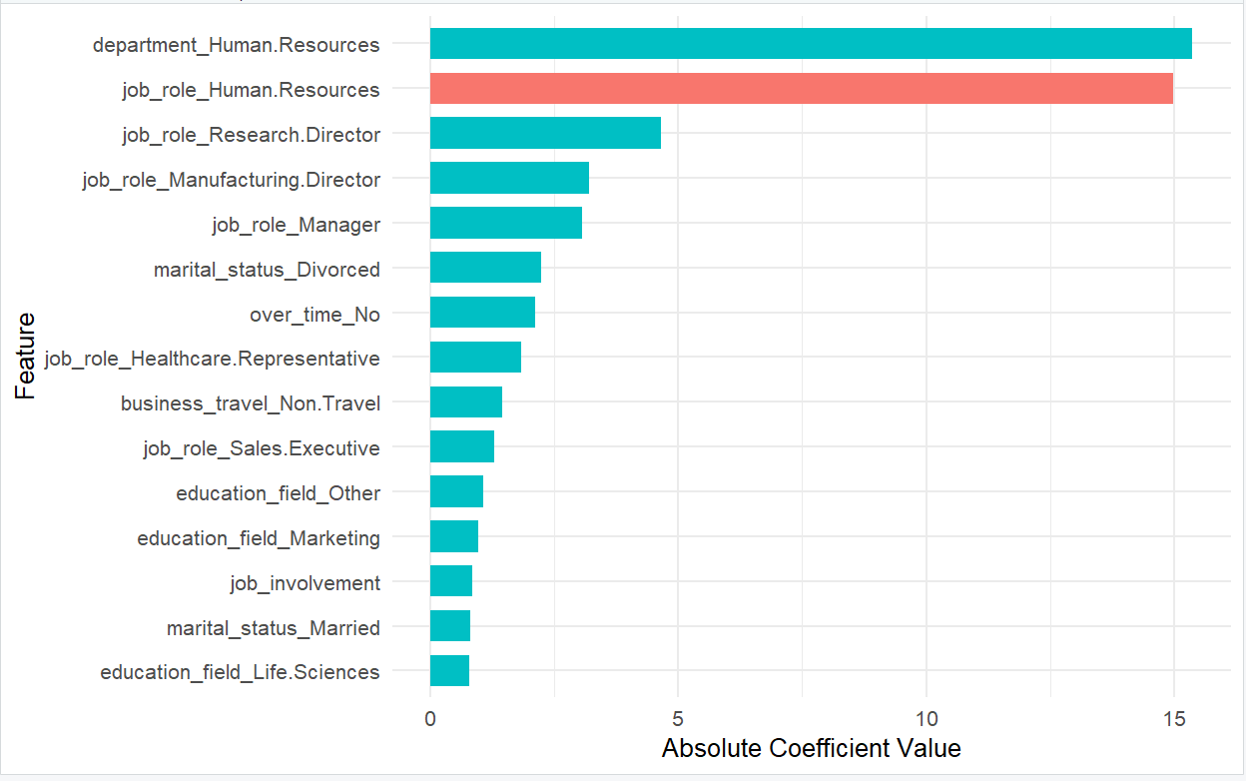
Top 15 Predictors of Attrition
The strongest predictors are Overtime, Monthly Income, and Years at Company.
These variables have the greatest influence on whether someone stays or leaves.
Identifies actionable levers for HR like adjusting workloads, review pay equity, and strengthen engagement.

Slide 15
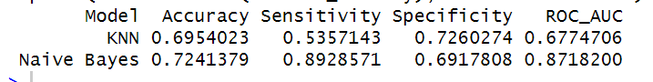
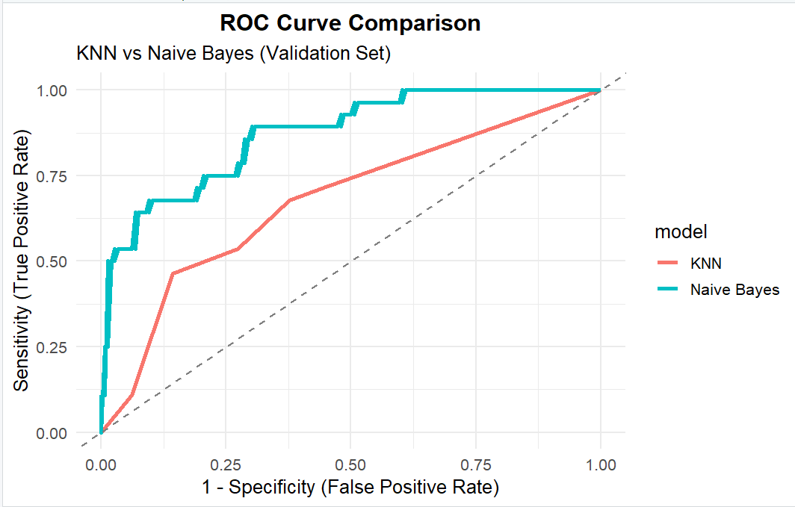
Results
Both models were trained on the same employee dataset to predict Attrition (Yes/No) outcomes.
The Naive Bayes achieved the strongest overall performance with a higher AUC score and better balance between sensitivity and specificity compared to KNN.
The Naive Bayes model generalized well across categorical and continuous features, while KNN was more sensitive to scaling and noise.
Both models demonstrated strong predictive power, confirming that income, job level, overtime status, and satisfaction are key drivers of employee attrition.

Slide 16
Thank you!

